Slide 1

Text analytics on deceptive and fake information on COVID-19
Name: CHEN BAOGANG
Matric number: 17186722/2
Supervisor: Dr. Siti Soraya binti Abdul Rahman
www.um.edu.my

Slide 2
01
Introduction
02
Literary Review
Overview
03
Research Methods
04
Result and Discussion
05
Conclusion

Slide 3
Background
01
In December 2019, an outbreak of pneumonia cases with unfamiliar symptoms was reported in Wuhan, China, leading to the identification of a novel coronavirus known as SARS-CoV-2 and the subsequent naming of the disease as COVID-19 by the World Health Organization (World Health Organisation, 2020). The rapid spread of COVID-19 to become a global pandemic was facilitated by modern travel and the widespread use of social media.
The popularity and usage of social media platforms have exponentially increased with the rapid development of the Internet and related technologies (J.Cement, 2020).While social media platforms have played a crucial role in disseminating information, they have also become breeding grounds for the circulation of false and misleading information about COVID-19 (Elhadad et al., 2020).
The dissemination of deceptive and fake information has severe consequences, including causing confusion, fostering mistrust, manipulating public opinion, and hindering effective response efforts (Domenico et al., 2021). Deceptive and fake information about COVID-19 can deter individuals from taking necessary precautions, promote belief in unproven treatments, and create challenges for healthcare workers and public health authorities.

Slide 4
Problem Statement
Spread of fake news lead to dangerous beliefs about masks and vaccines, as well as disregard for public health measures (Naeem et al., 2021), causing widespread mistrust of official health messages and the healthcare system as a whole (do Nascimento et al., 2022)
But current research have limited scope, limited feature extraction techniques, only focusing on one dataset and one feature extraction technique such as TF-IDF (Alenezi & Alqenaei, 2021; Das et al., 2021; Patwa et al., 2020).achieving high performance on a single data resource doesn't mean that the same level of performance can be extended to a wider range of datasets.
There is an urgent need for research investigating broader datasets from diverse sources, and comparing different feature extraction techniques that would enable a more comprehensive understanding and reliable detection of fake news related to COVID-19.

Slide 5
Research Questions
What are the impacts of deceptive and fake information on COVID-19 on individuals and society as a whole?
What are the different algorithms and techniques used in machine learning and deep learning to detect deceptive and fake information about COVID-19?
Which model demonstrates the highest effectiveness in detecting fake information related to COVID-19?

Slide 6
Research Objectives
To investigate deceptive and fake information on COVID-19
To employ different machine learning and deep learning models to detect fake information related to COVID-19
To evaluate different models on performance metrics and choose the best prediction model.

Slide 7
Related work
Citations | Article | Dataset description | Categories of features | Models | Analysis & Results
Patwa et al., n.d. (2020) . | Fighting an Infodemic: COVID-19 Fake News Dataset | 10,700 social media posts and articles of real and fake news on COVID-19 | numbers, dates, vaccine progress, government policies, hotspots | Decision Tree, Logistic Regression, Gradient Boost, and Support Vector Machine(SVM) | SVM performs the best F1-score with 93.32%.
Reis et al., 2019 | Supervised Learning for Fake News Detection | 2282 BuzzFeedNews articles about the 2016 U.S. election that have been labeled by journalists, | three levels, such as textual feature, news source features and environment feature | k-Nearest Neighbors (KNN), Naive Bayes (NB), Random Forests(RF), Support Vector Machine (SVM), and XGBoost (XGB) | RF and XGB, with AUC values of 0.85 (0.007) and 0.86 (0.006), respectively
Das et al., 2021 | A Heuristic-driven Ensemble Framework for COVID-19 Fake News Detection | 10,700 social media news items,the vocabulary size (i.e., unique words) of which is 37,505 with 5141 words in common to both fake and real news. | Article body, Username, domain | pre-trained models, like XLNet , RoBERTa , XLM-RoBERTa , DeBERTa , ERNIE 2.0 and ELECTRA models | best performing ensemble model consisting of RoBERTa, XLM-RoBERTa, XLNet , DeBERTa and novel heuristic algorithm based on username handles and link domains in tweets fetching an F1-score of 0.9883

Slide 8
Related work
Citations | Article | Dataset description | Categories of features | Models | Analysis & Results
Sahoo & Gupta, 2021 | Multiple features based approach for automatic fake news detection on social networks using deep learning | More than 15000 news contents from different Facebook users including both fake and real news | user profile (Profile ID, name, Date of join, All friends etc..) and news content features (Source, Headline, Body text, Statistical features etc..) | Machine learning classifiers (KNN,SVM Logistic Regression, Decision tree, Naïve Bayes) Deep learning classifiers (LSTM) | Accuracy KNN=99.3 SVM=99.3 Logistic regression=99.0 Decision tree=99.1 LSTM=99.4
Abdelminaam et al., 2021 | CoAID-DEEP: An Optimized Intelligent Framework for Automated Detecting COVID-19 Misleading Information on Twitter | 4 datasets, first is CoAID dataset, contains 4,251 news, 296,000 user engagements, 926 tweets referencing the COVID-19 and ground truth label, second is The disaster dataset, and third is PolitiFact dataset PolitiFact, and last is The gossip cop dataset | CoAID dataset (Id, text, location,keyword, target, feature extraction by TF-IDF | Decision Tree (DT), Random forest (RF), K-Nearest Neighbor (KNN),Support vector machine (SVM),Logistic Regression (LR),Naive Bayes (NB),Long Short-Term Memory (LSTM), ,Gated Recurrent Unit (GRU) | The Modified LSTM and The Modified GRU for the gossip cop dataset are outperforming SVM, DT,RF, NB, LR, and KNN for cross-validation and testing results, LSTM accuracy= 98.6%

Slide 9
Related work
Citations | Article | Dataset description | Models | Analysis & Results
J. Liu et al., (2023) | COVID-19 Fake News Detector | 10, 700 English posts | DT, RF, KNN, SVM, LR, GBC, NB, BERT, RoBERTa | BERT performs the best accuracy of 94.4%
Z. Tian et al., (2021) | Fake News Detection using Machine Learning with Feature Selection | BuzzFace consists of 2282 news articles | KNN, Genetic and Evolutionary Feature Selection (GEFeS) | With GETeS , KNN achieve a high accuracy of 91.3%.
R. Malhotra et al.,(2022) | COVID-19 Fake News Detection System | 10,700 tweets and online posts | feature extraction by TF-IDF, count vectorization ML models: DT, RF, KNN, SVM, LR, NB, LSVM, SGD DL models: LSTM, GRU, RNN | LSVM with TF-IDF achieves the highest testing accuracy of 94.11%
A. Jain et al., (2019) | A smart System for Fake News Detection Using Machine Learning | RSS Aggregator plugins to collect different source news | Naïve Bayes classifier, SVM, and NLP | SVM accuracy of 93.6%
K. Poddar et al., (2019) | Comparison of Various Machine Learning Models for Accurate Detection of Fake News | 13000 articles from Kaggle dataset | DT, NB, LR, SVM and Neural Networks feature extraction: Count Vectorizer and TF-IDF Vectorizer | SVM with the TF-IDF gave the most accurate prediction: 92.8 %

Slide 10
Related work - Research Gap
Existing studies primarily rely on datasets sourced from a single resource (Abdelminaam et al., 2021; Patwa et al.,2020; Sahoo & Gupta, 2021). lack of integration of multiple data resources
most researchers tend to focus on a single type of feature extraction, such as TF-IDF (Patwa et al., n.d. 2020; Reis et al., 2019; J. Liu et al., 2023).
lack of in-depth comparisons of hyperparameters and their impact

Slide 11
Related work - Summary
Studies highlights the use of 7 conventional ML models with excellent results are:
Decision Trees, Logistic Regression, Gradient Boost, k-Nearest Neighbors (KNN), Naive Bayes (NB), Random Forest (RF) and Support Vector Machine (SVM)
TF-IDF is widely feature extraction utilized in these studies
SVM with TF-IDF demonstrates the most accurate ML prediction performance across multiple studies (Patwa et al., 2020; R. Malhotra et al.,2022; K. Poddar et al., 2019).
Some studies have explored using an ensemble model that combines multiple pre-trained models with soft voting techniques

Slide 12







Methodology - OSEMN framework
Methodology
Obtain data
Scrub data
Explore data
Model data
Interpret the data

Slide 13
Methodology - Obtain data
Collect COVID-19 related datasets from different sources, such as twitter, facebook, fact-check website and kaggle. Below are the datasets of various misinformation related to covid-19 spread through social media and online platforms
● CONSTRAINT COVID-19 Fake News
● CoAID: COVID-19 Healthcare Deceptive and Fake information Dataset

Slide 14
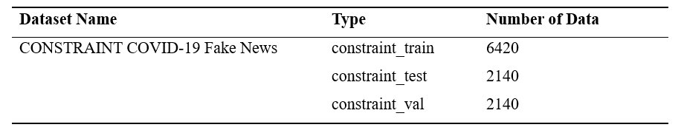
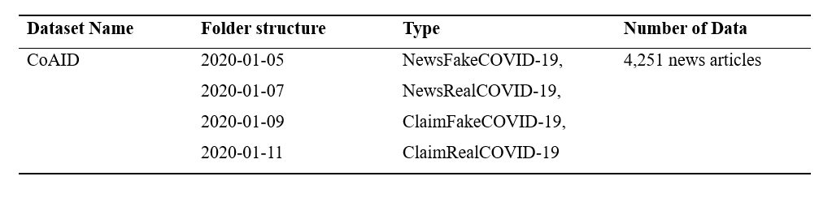
Methodology - Data Source and Type

Slide 15
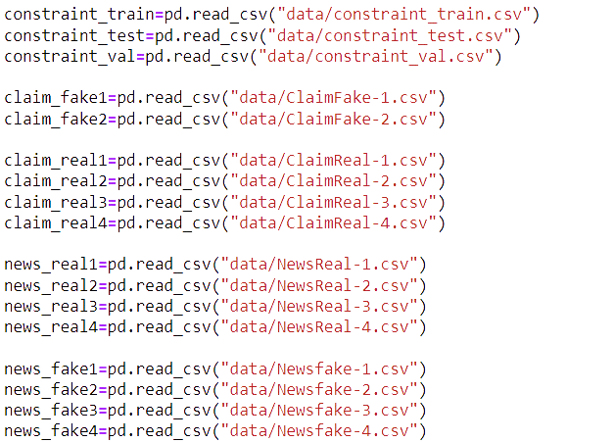
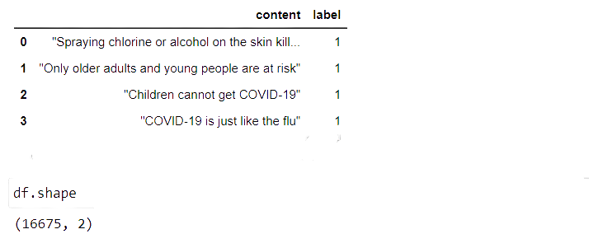
Methodology - Integration of diverse datasets

Slide 16
Methodology - Scrub data
Lower Casing: Converting all text to lowercase. This helps to standardize the text and reduce the number of unique words that need to be analyzed.
Removing unimportant data: Clearing data from invalid values
Tokenizing: Tokenization is the process of breaking up a sentence or paragraph into individual words or units.
Stop-word: does not contribute meaning to a sentence, such as articles, prepositions, conjunctions, and some pronouns. For example, the words “the”, “a”, “and” ,“is” will be identified as stop-words.
Steamming: by using the root word of each word, which helps avoid repetitive patterns.

Slide 17
Methodology - Explore data, Model data
Explore data : Explore the data called exploratory data analysis
to analyze and investigate datasets and summarize their main characteristics by employing data visualization methods
tools used to create an EDA include:
Python
R
Model data
7 commonly ML models : Decision Tree, Logistic Regression, Gradient Boost, Support Vector Machine (SVM), k-Nearest Neighbors (KNN), Naive Bayes (NB) , Random Forest (RF) based on literature review.
1 deep learning mode : LSTM

Slide 18




Methodology - Interpret data
Use a variety of evaluation measures to assess the performance of different models for building a fake formation detection system. Some commonly used evaluation measures for this type of system include accuracy, precision, recall, and F1-score:
Drawing conclusions from the datasets.
Evaluation of different models.
Select suitable models to build a detecting deceptive and fake information system

Slide 19
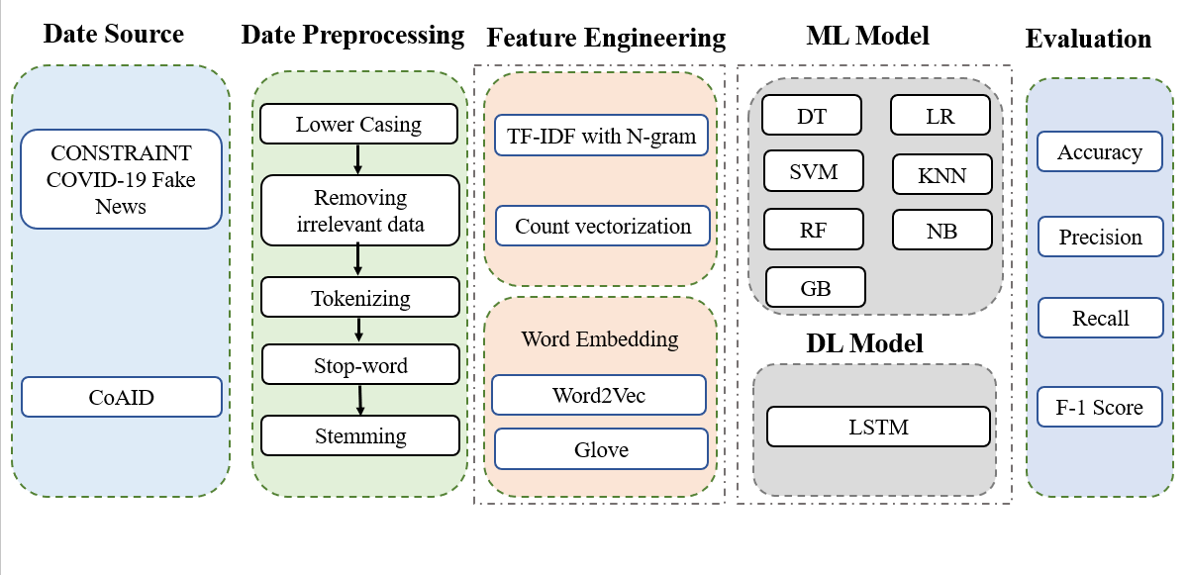
Methodology - System design

Slide 20
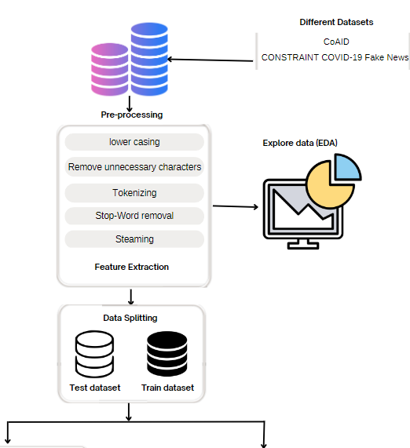
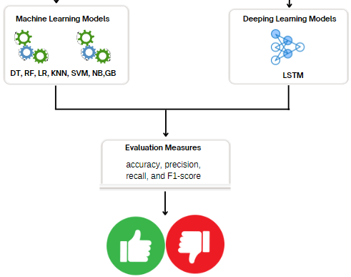
Methodology - Entire System design

Slide 21
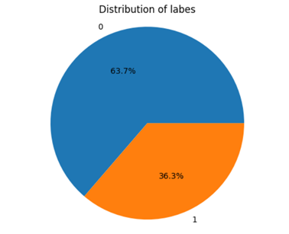
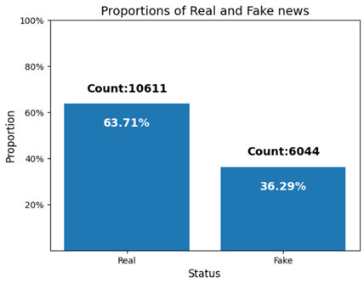
Exploration Data Analysis - Label balance

Slide 22
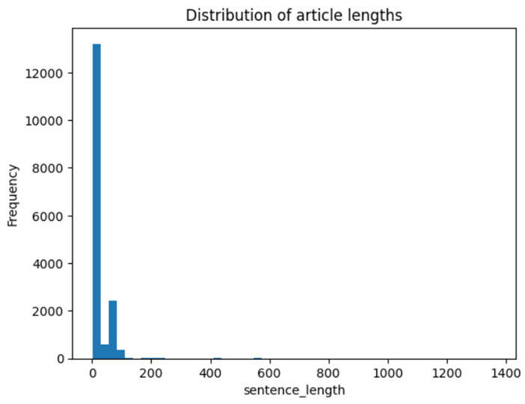
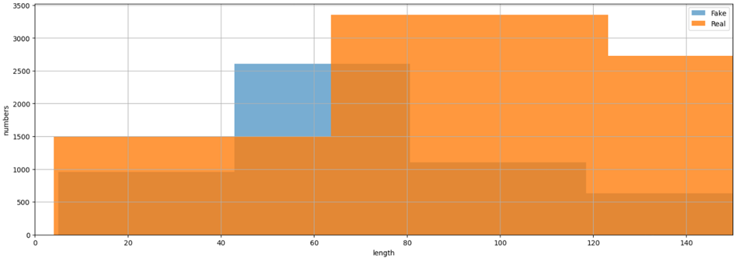
Exploration Data Analysis - Text length

Slide 23
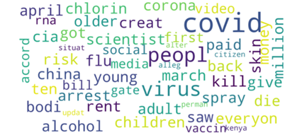
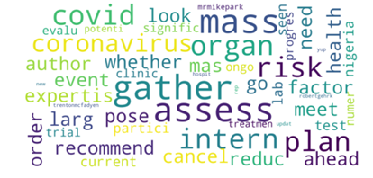
Exploration Data Analysis - Word Cloud
Fake news
True news

Slide 24
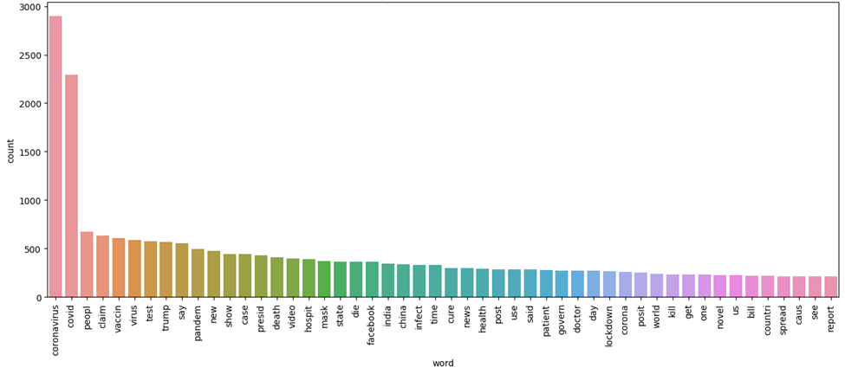
Exploration Data Analysis - Top words in fake news

Slide 25
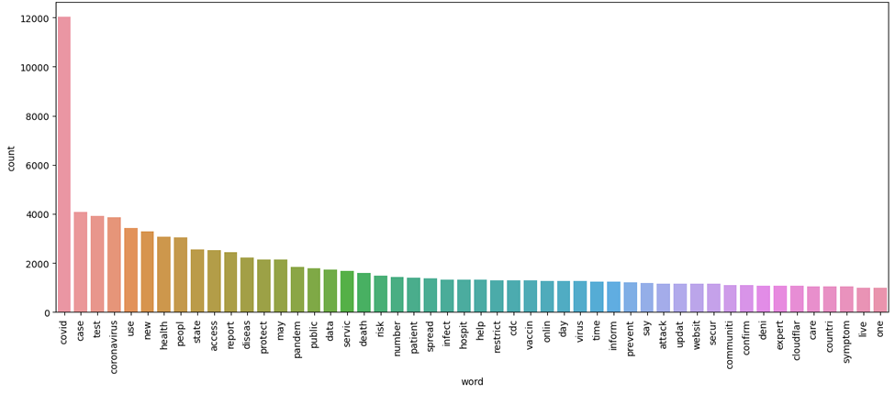
Exploration Data Analysis - Top Words in Real News

Slide 26

Experiements
Experiment 2
Experiment 4
Select optimal Hyperparameter
Evaluation of all Models’ performance
Experiment 1
Experiment 3
Evaluation of different Feature Extraction Techniques in ML models
Evaluation two word embedding methods : Word2Vec and Glove of the LSTM model.

Slide 27
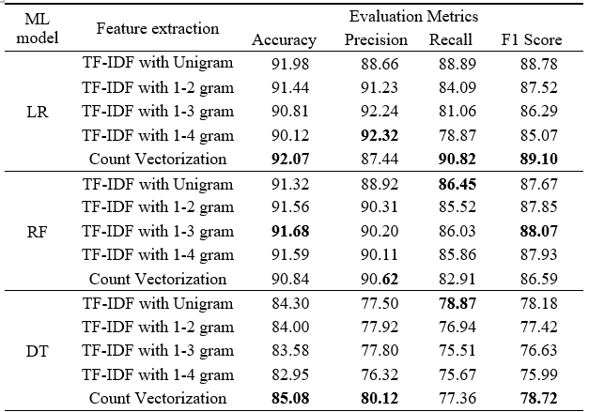
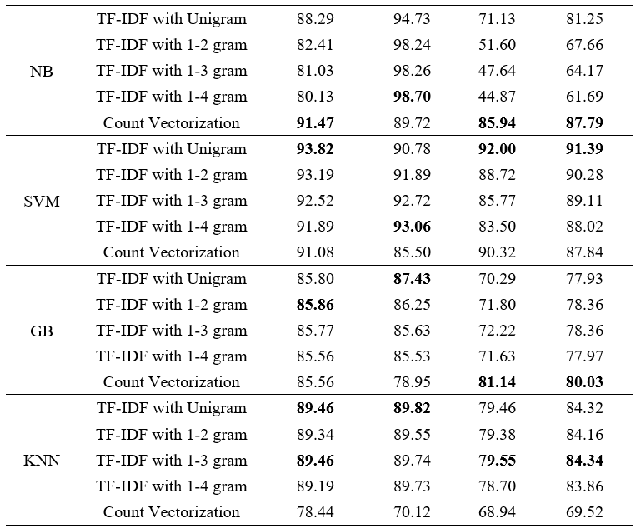
Experiment 1 Result- The Performance of Different Feature Extraction

Slide 28
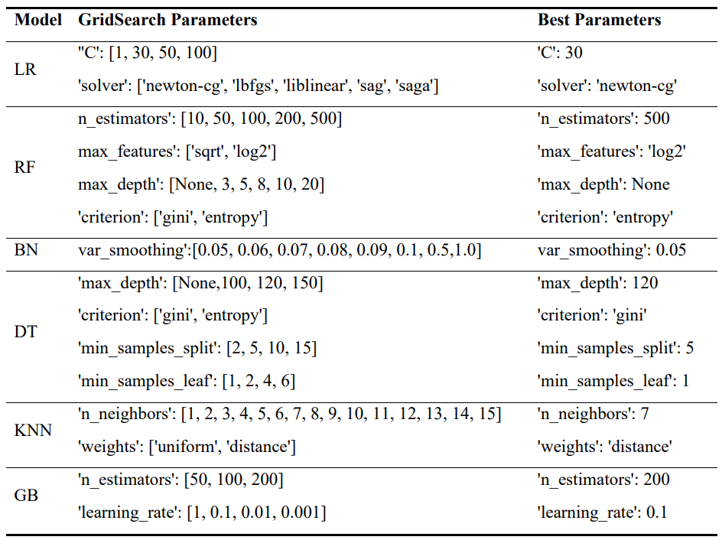
Experiment 2 Result - Hyperparameter

Slide 29
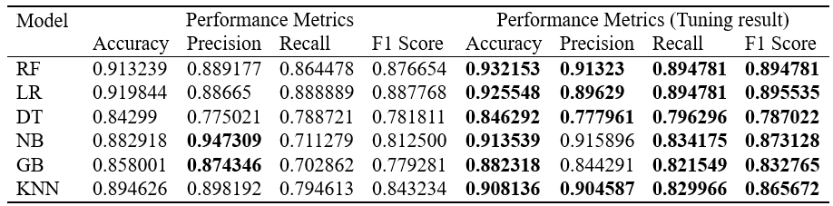
Experiment 2 Result - The Performance of ML with Best Hyperparameters
compare performance metrics for each model both before tuning and after tuning
tuning process resulted in improvements in the performance metrics across the different models, enhancing their accuracy, precision, recall, and F1 score

Slide 30
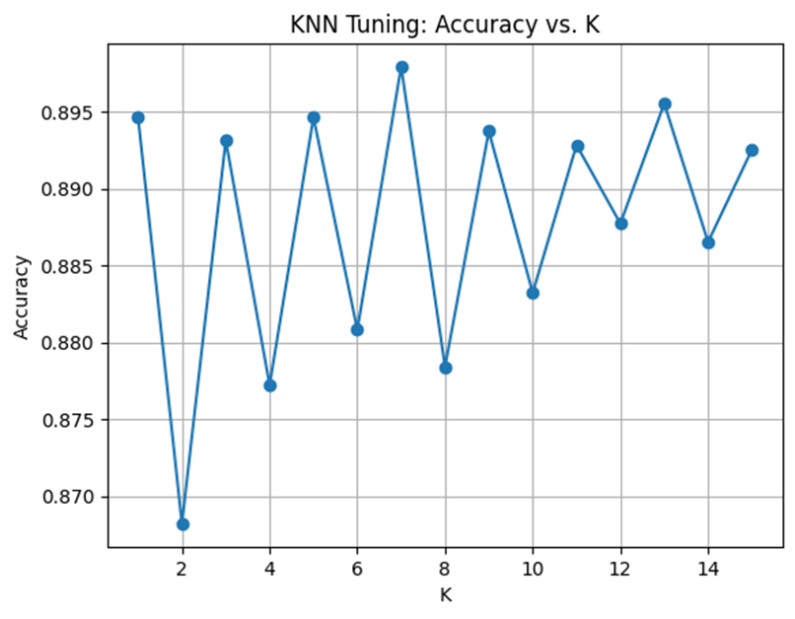
Experiment 2 Result - The Accuracy of KNN with Different K Value
the accuracy rate is at its lowest point, below 87.0%, when k is set to 2.
the highest accuracy rate, exceeding 90%, is achieved when k is set to 7.

Slide 31
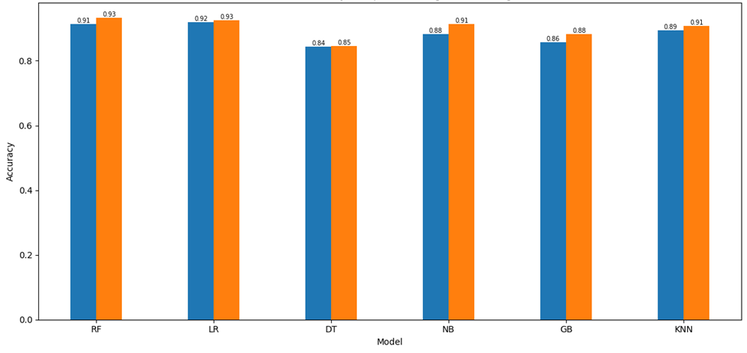
Experiment 2 Result- The Accuracy of ML with Optimal Hyperparameters

Slide 32
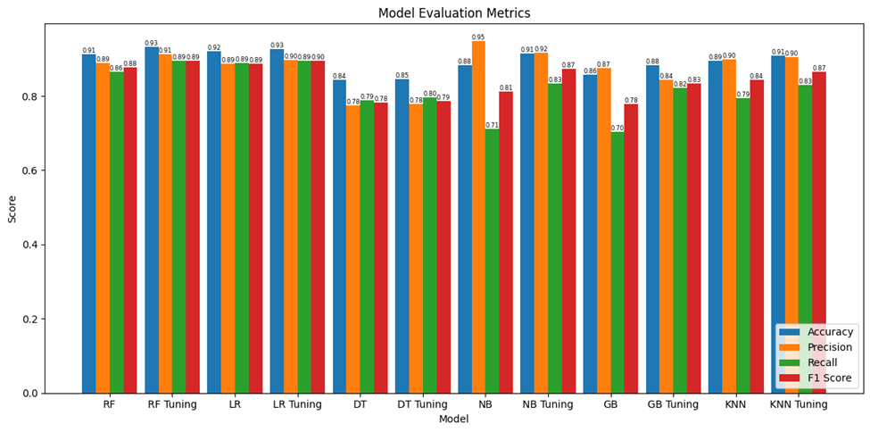
Experiment 2 Result- : Performance metrics of ML with Best Hyperparameters

Slide 33
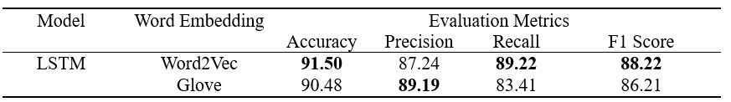
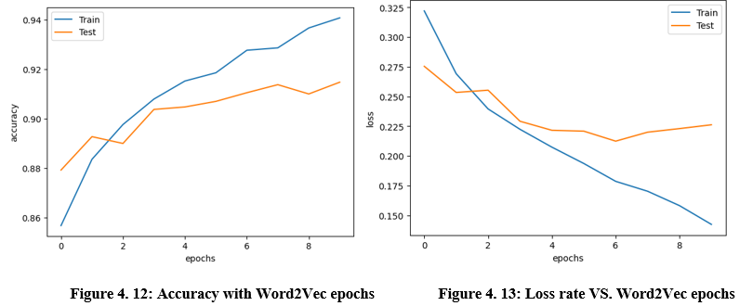
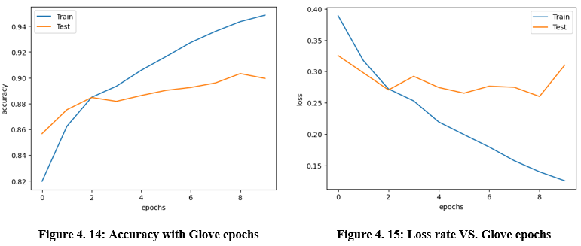
Experiment 3 - word2Vec VS Glove

Slide 34
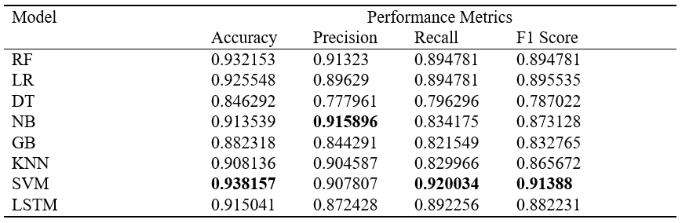
Experiment 4 Result- All Model Evaluation

Slide 35
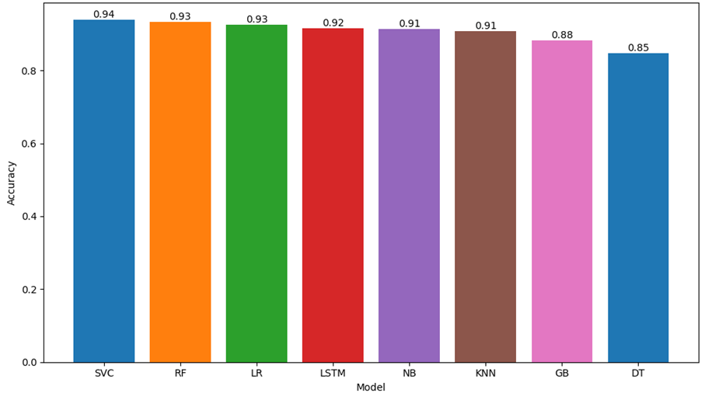
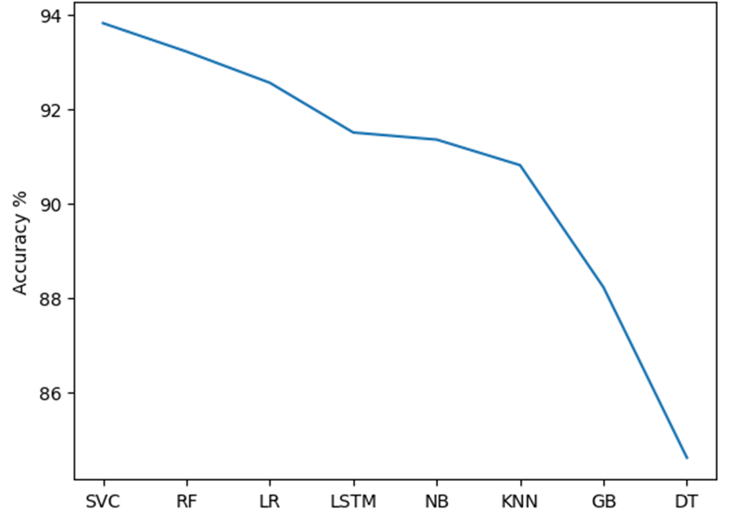
Experiment 4 Result- All Model Evaluation

Slide 36
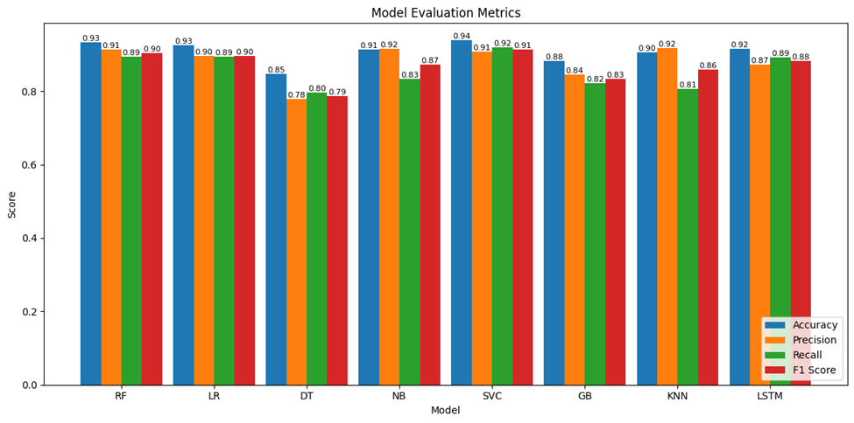
Experiment 4 Result- All Model Evaluation

Slide 37
Discussion
Based on Experiment 1, TF-IDF with 1-gram was selected as the feature extraction technique .
In Experiment 2, optimal parameters were determined for various machine learning models to maximize their performance.
Experiment 3 showed that Word2Vec performed well when combined with LSTM
In experiment 4, SVM is the top-performing model in this study dataset. This finding strongly supports the conclusions drawn in previous literature reviews conducted by Patwa et al. (2020), R. Malhotra et al. (2022), and K. Poddar et al. (2019), which demonstrated that SVM with TF-IDF consistently achieves high accuracy in machine learning predictive tasks across multiple studies.
Based on the experiments conducted, it is evident that the SVM model exhibits best performance compared to other models in the study, this finding provides us with strong evidence to support the use of the SVM model for building a COVID-19 fake information detection system.

Slide 38
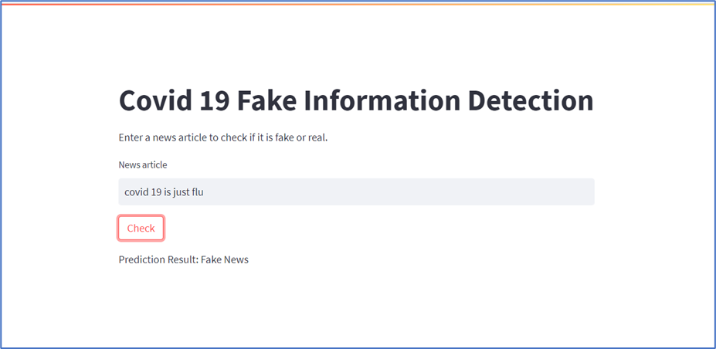
System deployment by SVM Model

Slide 39
CONCLUSION
we propose an improved approach for detecting COVID-19 fake information by integrating diverse COVID-19 related datasets, performing irrelevant data removal, text cleaning, tokenization, stopwords removal, and stemming.
Four experiments were conducted employing seven traditional machine learning models and one deep learning model.
Feature extraction for the machine learning models was based on TF-IDF and N-grams, while the deep learning model used word embedding.
Grid search with 5-fold cross-validation was employed to identify the optimal parameters for each model. The performance of both approaches was evaluated using accuracy, precision, recall, and F1-measure.
Results indicated that SVM achieved the highest accuracy across all models, with an accuracy of 0.938. Consequently, we implemented SVM with TF-IDF and 1-gram as the model to build COVID-19 fake information detection system.

Slide 40
IMPLICATIONS OF RESEARCH
This study explores the current machine learning algorithm for detecting false information and a Deep learning algorithm, and choose the algorithm with the best performance to build a covid 19 fake information detection system
provide a user-friendly, simple and easy-to-operate detection tool, just input any information, click detection, you can get the predicted result immediately .
By implementing with this system, researchers can develop automated systems to detect and combat the spread of covid 19 fake information, thereby ensuring public safety and trust in reliable sources.
Overall, the implications of this research are instrumental in combating the covid 19 fake information and ensuring accurate information dissemination during public health crises.

Slide 41
Limitation of Research
Mainly focuses on text-based features and content analysis and does not fully investigate the impact of other relevant features. For example, factors such as the source of the article, the field of source
Limited exploration of deep learning models. Although LSTM was implemented as the sole deep learning model, its performance did not demonstrate advantage over traditional machine learning models.

Slide 42
Recommendation
Different Deep learning model
further research should be conducted to investigate LSTM model with different architectures, and experiment with different deep learning modes, such as Convolutional Neural Networks (CNNs), Recurrent Neural Networks (RNNs), or Transformer-based models like BERT
Additional features
the investigation should extend to include additional features, such as the source of the article, the field of the source, and the credibility of the author. These factors have the potential to influence the performance of the detection system.

Slide 43
References
Alenezi, M. N., & Alqenaei, Z. M. (2021). Machine learning in detecting COVID-19 misinformation on Twitter. Future Internet, 13(10), 244. https://doi.org/10.3390/fi13100244
A. Jain, A. Shakya, H. Khatter and A. K. Gupta, "A smart System for Fake News Detection Using Machine Learning," 2019 International Conference on Issues and Challenges in Intelligent Computing Techniques (ICICT), Ghaziabad, India, 2019, pp. 1-4, doi: 10.1109/ICICT46931.2019.8977659.
R. Malhotra, A. Mahur and Achint, "COVID-19 Fake News Detection System," 2022 12th International Conference on Cloud Computing, Data Science & Engineering (Confluence), Noida, India, 2022, pp. 428-433, doi: 10.1109/Confluence52989.2022.9734144.
Borges do Nascimento, I., Beatriz Pizarro, A., Almeida, J., Azzopardi-Muscat, N., André Gonçalves, M., Björklund, M., & Novillo-Ortiz, D. (2022). Infodemics and health misinformation: a systematic review of reviews. Bulletin Of The World Health Organization, 100(9), 544-561. doi: 10.2471/blt.21.287654
Das, S. D., Basak, A., & Dutta, S. (2021a). A Heuristic-driven Ensemble Framework for COVID-19 Fake News Detection. http://arxiv.org/abs/2101.03545
Das, S. D., Basak, A., & Dutta, S. (2021b). A Heuristic-driven Uncertainty based Ensemble Framework for Fake News Detection in Tweets and News Articles. http://arxiv.org/abs/2104.01791
Elhadad, M. K., Li, K. F., & Gebali, F. (2020). Detecting misleading information on COVID-19. IEEE Access, 8, 165201–165215. https://doi.org/10.1109/ACCESS.2020.3022867
Patwa, P., Sharma, S., Pykl, S., Guptha, V., Kumari, G., Akhtar, S., Ekbal, A., Das, A., &Chakraborty, T. (n.d.). Fighting an Infodemic: COVID-19 Fake News Dataset. https://doi.org/10.1007/978-3
Reis, J. C. S., Correia, A., Murai, F., Veloso, A., Benevenuto, F., & Cambria, E. (2019). Supervised Learning for Fake News Detection. IEEE Intelligent Systems, 34(2), 76–81. https://doi.org/10.1109/MIS.2019.2899143
Sahoo, S. R., & Gupta, B. B. (2021). Multiple features based approach for automatic fake news detection on social networks using deep learning. Applied Soft Computing, 100. https://doi.org/10.1016/j.asoc.2020.106983
J. Liu and M. Chen, "COVID-19 Fake News Detector," 2023 International Conference on Computing, Networking and Communications (ICNC), Honolulu, HI, USA, 2023, pp. 463-467, doi: 10.1109/ICNC57223.2023.10074216.
R. Malhotra, A. Mahur and Achint, "COVID-19 Fake News Detection System," 2022 12th International Conference on Cloud Computing, Data Science & Engineering (Confluence), Noida, India, 2022, pp. 428-433, doi: 10.1109/Confluence52989.2022.9734144.
Z. Tian and S. Baskiyar, "Fake News Detection using Machine Learning with Feature Selection," 2021 6th International Conference on Computing, Communication and Security (ICCCS), Las Vegas, NV, USA, 2021, pp. 1-6, doi: 10.1109/ICCCS51487.2021.9776346.
K. Poddar, G. B. Amali D. and K. S. Umadevi, "Comparison of Various Machine Learning Models for Accurate Detection of Fake News," 2019 Innovations in Power and Advanced Computing Technologies (i-PACT), Vellore, India, 2019, pp. 1-5, doi: 10.1109/i-PACT44901.2019.8960044.
N. L. S. R. Krishna and M. Adimoolam, "Fake News Detection system using Decision Tree algorithm and compare textual property with Support Vector Machine algorithm," 2022 International Conference on Business Analytics for Technology and Security (ICBATS), Dubai, United Arab Emirates, 2022, pp. 1-6, doi: 10.1109/ICBATS54253.2022.9758999.
Domenico, G. di, Sit, J., Ishizaka, A., & Nunan, D. (2021). Fake news, social media and marketing: A systematic review. Journal of Business Research, 124, 329–341. https://doi.org/10.1016/J.JBUSRES.2020.11.037
J.Cement. 2020. Number of global social network user (2017-2025). https://www.statista.com/statistics/278414/number-of-worldwide-social-network-users/.
Kudarvalli, H., & Fiaidhi, J. (2020). Detecting fake news using machine learning algorithms.https://doi.org/10.36227/techrxiv.12089133
Naeem, S. bin, Bhatti, R., & Khan, A. (2021). An exploration of how fake news is taking over social media and putting public health at risk. In Health Information and Libraries Journal (Vol. 38, Issue 2, pp. 143–149). Blackwell Publishing Ltd. https://doi.org/10.1111/hir.12320
Hundreds die of poisoning in Iran as fake news suggests methanol cure for virus Hundreds die of poisoning in Iran as fake news suggests methanol cure for virus. (2020). Retrieved 23 June 2023, from https://www.timesofisrael.com/hundreds-die-of-poisoning-in-iran-as-fake-news-suggests-methanol-cure-for-virus/
Palosky, C. (2021). Covid-19 misinformation is ubiquitous: 78% of the public believes or is unsure about at least one false statement, and nearly a third believe at least four of eight false statements tested. KFF. Retrieved November 1, 2022, from https://www.kff.org/coronavirus-covid-19/press-release/covid-19-misinformation-is-ubiquitous-78-of-the-public-believes-or-is-unsure-about-at-least-one-false-statement-and-nearly-at-third-believe-at-least-four-of-eight-false-statements-tested/
United Nations. (2020). During this coronavirus pandemic, 'fake news' is putting lives at risk: UNESCO | | 1UN news. United Nations. Retrieved November 1, 2022, from https://news.un.org/en/story/2020/04/1061592
Wikimedia Foundation. (2023, January 23). Misinformation. Wikipedia. Retrieved January 28, 2023, from https://en.wikipedia.org/wiki/Misinformation
World Health Organization. (2020, June 29). Listings of who's response to covid-19. World Health Organization. Retrieved January 28, 2023, from https://www.who.int/news/item/29-06-2020-covidtimeline
World Health Organization. (2020, March 11). Who director-general's opening remarks at the media briefing on COVID-19 - 11 march 2020. World Health Organization. Retrieved January 28, 2023, from https://www.who.int/director-general/speeches/detail/who-director-general-s-opening-remarks-at-the-media-briefing-on-covid-19---11-march-20
Reference

Slide 44

Thank You

